Slide 1
WHERE MY [ANIMAL] AT
a revolutionary approach to wildlife tracking

Slide 2
TRACKING [WILDLIFE]
Helps us understand how animals move within different areas through time
Used to address climate and land use change, invasive species, and spread of diseases
Tracking methods include GPS, Argos Doppler, Very High Frequency (VHF) Radio Transmitters, Light-Level Geolocators, and Tracking Bands and Rings
Current methods to analyse tracking data are not intuitive, such as Movebank and wildlifetracking.org
A more user-friendly experience is required to make wildlife tracking data more accessible to analyse

Slide 3
USING THE [APPLICATION]
Select the species
Select the animal and parameters
Select the timeframe
View tracking data

Slide 4
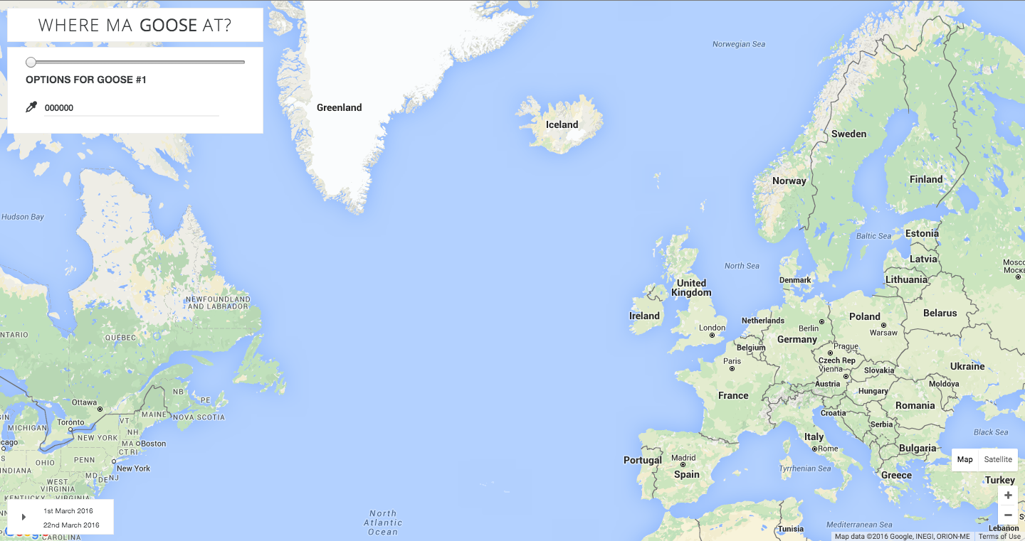

Slide 5
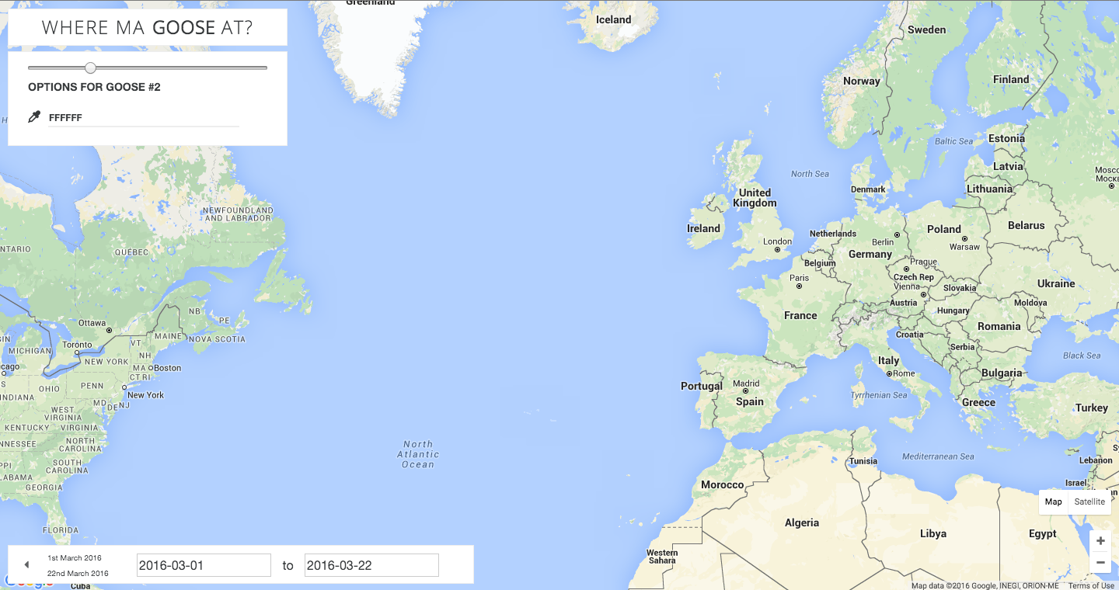

Slide 6
HOW IT [WORKS]
Geographic coordinate and time data from Movebank Data Repository API is loaded into Django server
Longitude and latitude is converted into position vectors originating from the centre of the Earth
Positions are fitted onto a polynomial curve, future positions are predicted through mathematical algorithms
Positions are retransformed into geographic coordinates
Front-End connects to Back-End Server to retrieve data
User interface displays the location and predicted future positions based on user-set parameters onto map based on Google Maps API

Slide 7
[RESOURCES]
What is animal tracking? (n.d.). Retrieved March 13, 2016, from https://www.movebank.org/node/857

Slide 8
[QUESTIONS] AND [ANSWERS]
WHERE MY [ANIMAL] AT
christophe gaboury | jordan hu | joshua kwok | paul xu

